Slide 1
FINCENT PRESENTATION
Presentation is intended to provide an overview of FINCENT's activities
CDR Jukka-Pekka Schroderus
06OCT2015

Slide 2
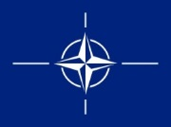
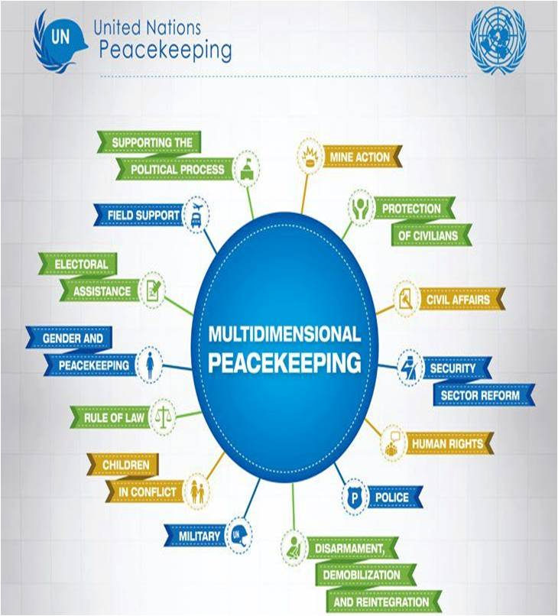


Comprehensive Approach and Human Security
UNSCR 2086
21 Jan 2013
Notes:
VIKING’S multidimensional and multifunctional approach provides a unique opportunity for a wide range of professional disciplines to meet and train in a realistic environment.
It reflects the latest policy on multidimensional peacekeeping as defined in the UNSCR 2016 as of the 21 Jan 2013.
Beside United Nations, the exercise will have participation from Nato, EU and AU,
1

Slide 3
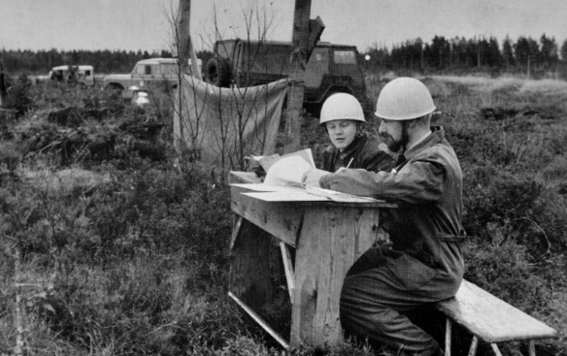


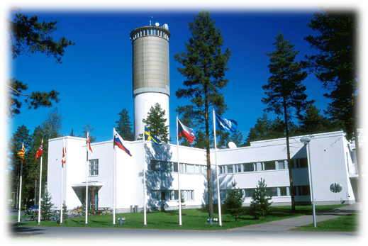


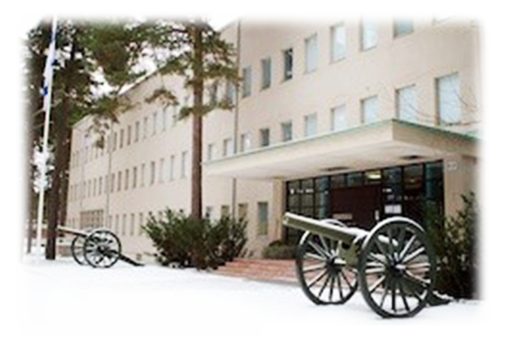
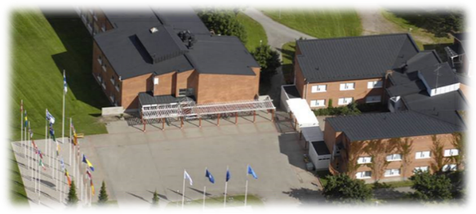
History
1969 First Peacekeeping Training Centre
2001 Reorganized as PfP- Training Centre
2008 Relocated to Tuusula
2015 MC2PS (Military Contribution to Peace Support) Department Head (DH) Status (?)
2015 Integration with National Defense University

Slide 4
National Defence University Organisation 2015
Student’s
Union
Rector
Advisory
Board
Vice Rector
Director of Community and International Relations
Research
Director
Administrative Director
Headquarters
Planning Unit
Personnel Unit
Services Unit
Division of Registrar and Student Services
Department of Warfare Studies
Department of Leadership and
Military Pedagogy
Military Museum*
Military
Academy
Master’s Degree Prog-
ramme
Post-graduate Prog-ramme
Doctoral Prog-
ramme
(virtual
organisation)
Department of Military Technology
National Defence Courses*
Defence Language Centre
Library
Finnish Defence Forces International Centre
*
outside of
Santahamina

Slide 5
FINCENT’s Tasks
To conduct national and international courses, exercises and seminars for the UN, the EU, NORDEFCO, NATO and NATO/Partnership and the AU (African Union)
To act as the Department Head for NATO PSO (Peace Support Operations)
To act as a FDF OCC E&F (Operational Capabilities Concept Evaluation and Feedback) Centre of Expertise
To support Finnish civilian crisis management efforts
To administrate dispatching of Finnish students and instructors to participate in courses abroad
To cooperate with international and national civilian and military partner organisations
Main focus: Military leaders and experts (except OCC)

Slide 6
FINCENT Organisation 2015
Commandant
17 Officers and NCO’s
8 Civilians
25 TOTAL
+ 1 SWE LNO (Liaison Officer)
Course Section
PSO Education & Training Coordination Section
Course Branch
Course Support Branch
Pool of Instructors
(30–40)
Pool of Role Players
Projects:
EUCCM (EU Comprehensive Crisis Management Course )
ACB (African Capacity Building)
UNPOC (United Nations Protection of Civilians Course)

Slide 7
Strategy
Perspective | Vision
Effectiveness | International status | Respect – Continuous improvement
Customer | Customer centricity | Communication – Requirements management
Process | Processes and efficiency | Conditioning – Performance measurement
Personnel | Know-how and internationalism | Competence – Globalisation

Slide 8
Values
Cultural awareness
Customer focus
Striving for development
Expertise
Life-long learning

Slide 9
Mission
The mission of FINCENT is to execute and conduct the international training of leaders and experts in crisis management in cooperation with its national and international partners.
FINCENT also supports other Finnish Defence Forces units with its expertise in terms of training and evaluation.

Slide 10
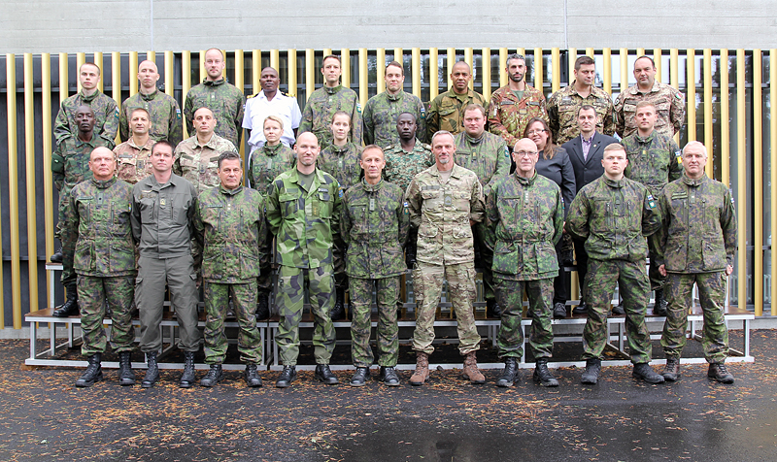
Objective
FINCENT defines, unifies and synchronises military contribution to Peace Support Education and Training (E&T) to find the most collaborative, effective, efficient and affordable training solutions possible.
NORDEFCO Peace Support Operations Cooperation Course.
The objective of this 12-day course is to prepare nationally trained officers heading for a NATO, UN or EU-led Peace Support Operation for coordination, liaison and cooperation tasks. (17 students, 6 nationalities)

Slide 11
Vision
FINCENT is nationally and internationally known and recognised forerunner, expert and active participant in crisis management education and training that produces certified training packages relating to comprehensive crisis management.
As a national actor FINCENT is actively creating and developing multinational crisis management training.
FINCENT has an University Status and Education and Training based on studies.

Slide 12


Quality Assurance
UNITED NATIONS CERTIFICATE OF TRAINING RECOGNITION
NATO QUALITY ASSURANCE ACCREDITATION
NDU ASSURANCE OF TRAINING QUALITY
ISO 9001
CERTIFICATION

Slide 13

Command and Control
President
Civilian Crisis Management
Government
Military Crisis Management
Ministry of the Interior
Ministry for
Foreign Affairs
Ministry of Defence
Defence Command
S T R A T E G Y
NDU
CMC Finland
FINCENT
Commands
The Finnish Centre of Expertise in
Comprehensive Crisis Management

Slide 14
Peace Support Operations Execution
Defence Command
Army
Navy
Air Force
Personnel
FINCENT
Key Leader and Expert Training
MCC
Unit Training
LCC
ACC
PSO

Slide 15


Viking 14 Planned Training Audience Organisation
Response cells
- Higher Control
UN HQ
IO/GO
RO / NGO
EEAS/
CPCC
(O)HQ
Joint Forces Command
Training Audience
- Operational level
UNMIB HQ
Country
Offices
BFOR HQ
EUCAM HQ
(F)HQ
DSRSG
Political
DSRSG
RC/HC
UN
COUNTRY
TEAM
Land
Component
Air
Component
Maritime
Component
UN
POLICE
UN
MILITARY
Training Audience
- Tactical
level
Brigade
HQs
Combined Air
Operations
Centre
Navy
Task
Groups
Regional
Offices
Sector
HQ
Regional
Offices
Response cells
-Lower Control
Field
Staff
Subordinate
units
Field
Staff
Field
Staff
Subordinate
Units
Subordinate
units
Subordinate
units
Subordinate
units
Notes:
VIKING 14 trains headquarters and offices on the operational and tactical level as visualized between the two red dotted lines on the picture.
The higher control on the strategical level and the units and staff deployed on the lower tactical level are played by response cells.
Mission HQ’s and Country Offices will be trained at the C2 Regiment in Enköping, Sweden. ACC, MCC, Brigade HQ´s and Regional Offices will be trained at distributed sites in Sweden, Irland, Serbia, Bulgaria and Georgia.

Slide 16
Crisis Management Budget
Crisis Management Budget €116,000,000
Crisis Management Education and Training €6,500,000
Finland, Gross Domestic Product (GDP)
Finnish Defence Forces Budget
€2.658 billion (1.28% of GDP)

Slide 17

UN Courses
United Nations Military Experts on Mission Course (UNMEM)
United Nations Protection of Civilians Course (UNPOC)
NATO Courses
Comprehensive Operations Planning Course (COPC)
NATO Partnership Logistics Course (LOC)
NATO Partnership Communication and Information Systems Course (CIS)
N3-24 ACO Combat Readiness Evaluation Course for Land Forces (nCREVAL)

Slide 18


EU Courses
European Union Comprehensive Crisis Management Course (EUCCM)
European Security and Defence College Core Course on Security Sector Reform (EUDC CORE SSR)
Generic Courses
Integrated Crisis Management Course (ICM)
Peace Support Operations Cooperation Course (PSOCC)
Security Sector Reform Course (SSR)

Slide 19


National Courses
National Military Staff Officer Course (NMSO)
Military English Course (MEC) (12 students 4 times per year)
  The aim of the course is to enhance the language skills of Finnish military personnel in preparation for duties in crisis management or international tasks. The courses are blended learning courses including two three-day instructor-led periods and two three-week distance learning periods during which students complete different assignments.
Military French Course (MFC) (12 students once per year)
Peace Support Operations Terminology Course (PSOTC) (15 students 2 times per year)
  The aim of the three-day course is for students to broaden their military vocabulary and activate their military English language skills.
UNIFIL Logistics Course (UNIFIL LOC)
Seminars

Slide 20









International Cooperation
ESDC
Crisis
Management
Operations
EAPTC

Slide 21
Partnership Training and Education Centres
Finnish Defence Forces International Centre
Partner Language Training Center Europe, United States
Swedish Armed Forces International Centre
Slovak Armed Forces Academy of General M. R. Stefanik
German Armed Forces United Nations Training Centre
International Peacekeeping and Security Centre, Ukraine
Austrian Armed Forces
International Centre
Five Hills Peace Support Operations Training Centre, Mongolia
Defence Academy of the
United Kingdom
Continuous Training Centre of the Armed Forces Military Academy, Moldova
Training Centre Swiss Armed Forces International Command
Partnership for Peace Training Centre of the Army Academy, Kazakhstan
Geneva Centre for Security Policy, Switzerland
Regional Department of Defence Resources Management Studies, Romania
Slovenian PFP Language
Training Centre
Sachkhere Mountain Training School, Georgia
International Institute of Humanitarian Law, Italy
Turkish PFP Training Centre
Naval Postgraduate School, United States
Peace Support Operations Training Centre, Bosnia and Herzegovina
Crisis Management and Multinational Operations Department, Romania
Jordan Armed Forces
Language Institute
Joint Special Operations University, United States
Chemical, Biological, Radiological and Nuclear Training Centre, Serbia
Peace Operation Training Centre, Jordan
Public Affairs Regional Centre,
The Former Yugoslav Republic of Macedonia
Hellenic Multinational Peace Support Operations Training Centre, Greece
Foreign Languages Department of the National Military University, Bulgaria
Cairo Centre for Training on Conflict Resolution and Peacekeeping in Africa, Egypt

Slide 22
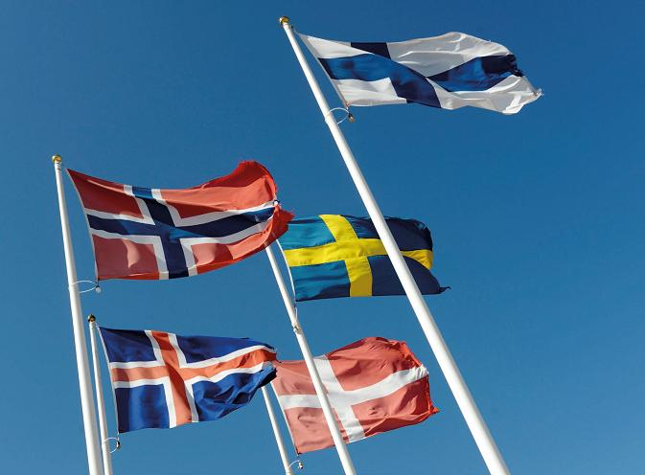

Nordic Defence Cooperation
The main aim and purpose of the Nordic Defence Cooperation (NORDEFCO) is to strengthen the participating nations’ national defence, explore common synergies and facilitate efficient common solutions.

Slide 23
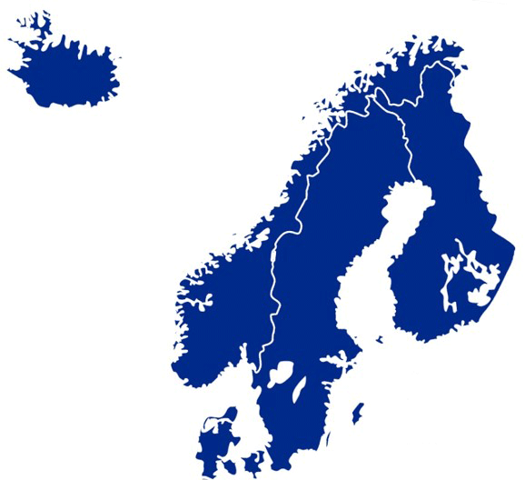






Cooperation Areas HR & Education
Competent instructors
Build-up of expertise
National control
A cost-effective
”win-win” situation
ICELAND
NORWAY
Logistics
FINLAND
Military Experts on Mission
LNO (Liaison Officer)
CIS Communication and Information
DENMARK
CIMIC
Military Police
SWEDEN
Staff Duties
Gender

Slide 24

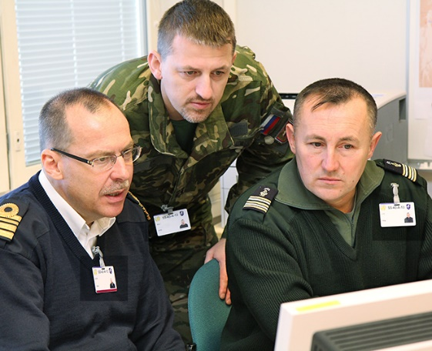
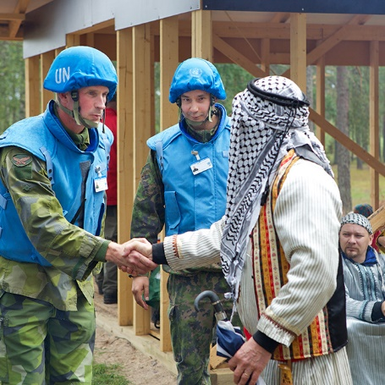
Finnish Centre of Expertise in
Comprehensive Crisis Management
Promoting Comprehensive Approach

Slide 25
MC2PS Department Head FINCENT
Political / Military Direction & Guidance
Global Standard
Right Training for Right People in PSO
PSO
Strategic Training Plan
Holistic View
NATO
Training Requirements Analysis
Programme
Training Needs Analysis
FINCENT
Courses
PSO Trends – AU, EU, NATO, UN

Slide 26
Becoming a DH
March 2012: First discussion with JFT
September 2012: National approval intention
Chicago Summit: Political declaration
November 2012: First MOU Draft
February 2013: First STP Draft
January 2014: RA Appointment
June 2014: Third STP Draft, staffing
September 2014: MC2PS (AJP 3.4.1)
November 2014: Final STP
April 2015: BI-SC agreed (STP)
June 2015: STP staffing by MC

Slide 27
Tasks for DH
To improve partners’ future interoperability with NATO through the preparation for their MC2PS
To combine and synchronise the education and training effort
To provide a flexible, adaptive and high quality E&T MC2PS system
To produce TNA
To organise ADC

Slide 28

FDF OCC E&F Centre of Expertise
Established in 2013
FDF OCC E&F Centre of Expertise supports the planning, preparation and execution of all evaluations
Outlining the guidance of national
OCC E&F process and tasks
Evaluation mechanism supports
force generation
Notes:
OK
Established in 2013
IOT support the Defence Forces evaluations of units submitted to NATO Pool of Forces
Implement best practices from NATO OCC E&F to national evaluation
FDF OCC E&F Centre of Expertise supports the planning, preparation and execution of all evaluations
Level 1 expertise (Support Level 2 expertise)
OCC E&F Tool and database (LAN with work stations and server)
Nationally conducted supporting training for evaluators
Managing the national pool of evaluators and subject matter experts (SME)
Coordinating Level 1 and database training
Outlining the guidance of national OCC E&F process and tasks
Evaluation mechanism supports force generation in relation to
NATO-led operations
NATO Response Force
Defence Forces modernisation

Slide 29




Finnish Crisis Management Participation
MALI
MINUSMA
5
2013–
BOSNIA
ALTHEA
8
2004–
KOSOVO
KFOR
21
1999–
LEBANON
UNIFIL
364
2012–
MIDDLE EAST
UNTSO
17
1967–
AFGHANISTAN
ISAF
79
2002–
KASHMIR
UNMOGIP
7
1961–
MALI
EUTM
10
2013–
SOMALIA
ATALANTA
5
2008–
LIBERIA
UNMIL
2
2003–
SOMALIA
EUTM
7
2010–
RCA
EUFOR RCA
23
2014–
Participation total: 548

Slide 30
Facts and Figures
Every year FINCENT
  educates 700–800 students
  conducts 30–40 international courses and events
  educates 120–150 students abroad
  conducts courses abroad
    Mobile Education and Training Teams (METT)
  provides 60–70 instructors for NORDEFCO and PTEC purposes.

Slide 31
Global Programming
Governance structure – Responsibilities – Development methodology
DISCIPLINES
ACT
Right
Training
People
Time
Place
JFT
Strategic Training Plan
Holistic View
RAs
Training Requirements Analysis
Programme
DHs
Training Needs Analysis
Courses

Slide 32
Department Head FINCENT (?)
Political / Military Direction & Guidance
Global Standard
Right
Training
People
Time
Place
MC2PS
Strategic Training Plan
Holistic View
NATO
Training Requirements Analysis
Programme
Training Needs Analysis
FINCENT
Courses
PSO Trends – AU, EU, NATO, UN

Slide 33
TRA – TNA – ADC
Collect
opportunities
Stratify / classify opportunities
DoK 100 – 500
Stratify / classify requirements
DoK 100 – 500
1
2
3
NEW REQUIREMENTS
Identify gaps & duplications
Match E&IT – CT&E
requirements &
opportunities
5
4
Close gaps,
eliminate duplications, manage programme
As evolution occurs,
refine TRA within management
structure as needed
6
7

Slide 34
The Effect of a Discipline
Disciplines serve to align requirements with solutions
Disciplines provide a structure to categorise and capture requirements
Potential solutions to satisfy requirements can subsequently be identified
Courses can be compared with requirements to identify gaps and overlaps
Requirement
Exercise
Requirement
Course
Requirement
Exercise
Requirement
Course
Requirement
Training
Requirement
Course
Requirement
Training
MC2PS
DISCIPLINE

Slide 35
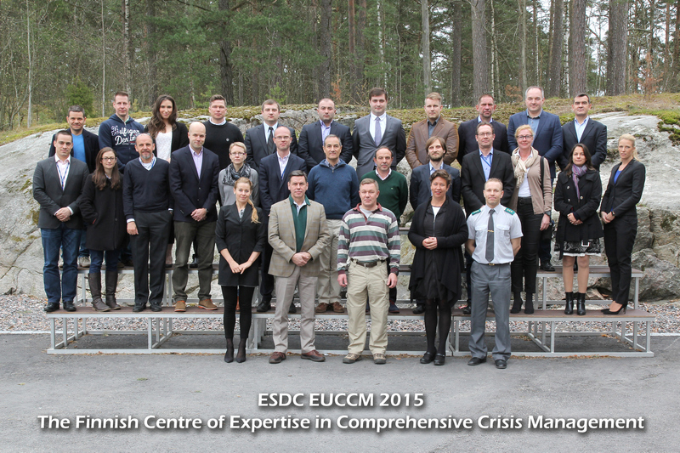
FINCENT is an active actor with its view to the future
”Governments understand that they cannot address today’s threats, or seize today’s opportunities, on their own. They need the private sector, civil society groups, philanthropic foundations, academic institutions – all those with the capacity to contribute – to do their part. And they need to cooperate with each other and with all stakeholders as never before. This is – and must be – an era of partnership”
UN Seceretary-General Ban Ki-Moon (22APR2009)
The EU Comprehensive Crisis Management Course’s (EUCCM) pilot course brought together 23 military, police and civilian crisis management experts from 11 different nations to enhance their knowledge and understanding of the Comprehensive Approach.

Slide 36
With valid attitudes, education and training there are always solutions
EVERY ACTION MATTERS
fincent.fi
fincent@fincent.fi

